Slide 1
Understand flink concepts

Slide 2
Flink
Flink Programming Model
Flink Distributed Runtime Environment
Flink watermarks
Flink triggers
Flink states & fault tolerance
Anatomy of a Flink Program
Flink hello world analysis
Flink Evictors
Flink Allowed Lateness

Slide 3
Flink Programming Model

Slide 4
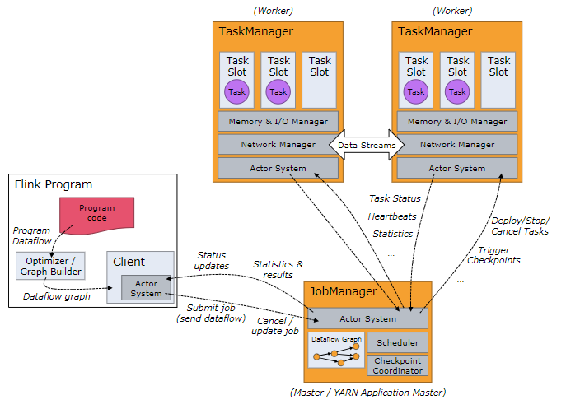
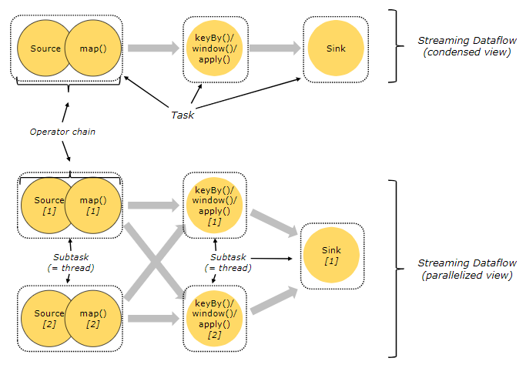
Flink Distributed Runtime Environment
Tasks and Operator Chains
Tasks=chains operator subtasks together
Job Managers, Task Managers, Clients
JobManagers： coordinate the distributed execution
schedule tasks
coordinate checkpoints
coordinate recovery on failures
TaskManagers： execute the tasks of a dataflow
buffer
exchange the data streams
Clients
Is not part of the runtime and program execution
is used to prepare and send a dataflow to the JobManager

Slide 5
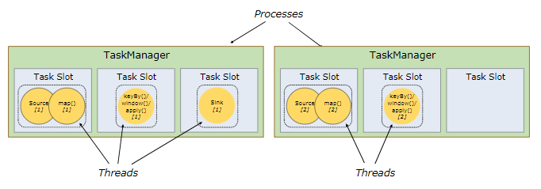
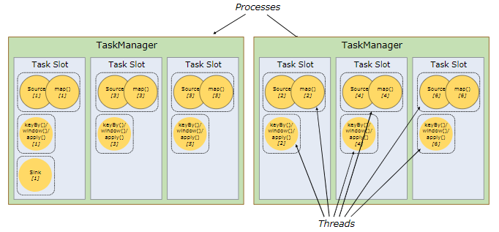
Flink Distributed Runtime Environment
Task Slots and Resources
TaskManager = JVM process = execute subtasks in separate threads
To control how many tasks a TaskManager accepts -> taks slot
slot sharing
Notes:
允许slot共享有以下两点好处：
Flink 集群所需的task slots数与job中最高的并行度一致。也就是说我们不需要再去计算一个程序总共会起多少个task了。
更容易获得更充分的资源利用。如果没有slot共享，那么非密集型操作source/flatmap就会占用同密集型操作 keyAggregation/sink 一样多的资源。如果有slot共享，将基线的2个并行度增加到6个，能充分利用slot资源，同时保证每个TaskManager能平均分配到重的subtasks。

Slide 6
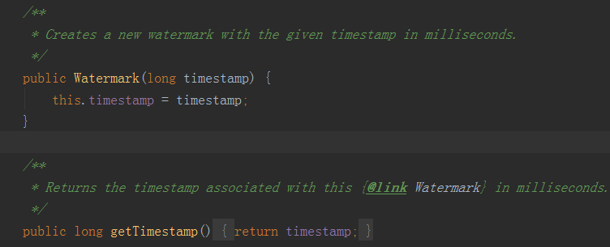
Flink watermarks
Watermarks是什么？
时间戳
Periodic Watermarks
周期性的触发watermark的生成和发送
默认是100ms，时间间隔由ExecutionConfig.setAutoWatermarkInterval
可以定义一个最大允许乱序的时间
实现AssignerWithPeriodicWatermarks接口
Punctuated Watermarks
基于某些事件触发watermark的生成和发送
基于事件向流里注入一个WATERMARK
实现AssignerWithPunctuatedWatermarks接口
Notes:
A Watermark tells operators that no elements with a timestamp older or equal to the watermark timestamp should arrive at the operator
它高数operators应该到达这个opterator的elements的时间戳没有老于或者等于这个watermark的时间戳

Slide 7
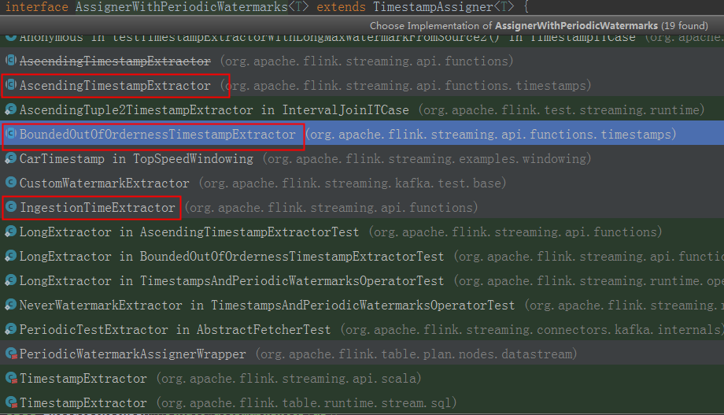
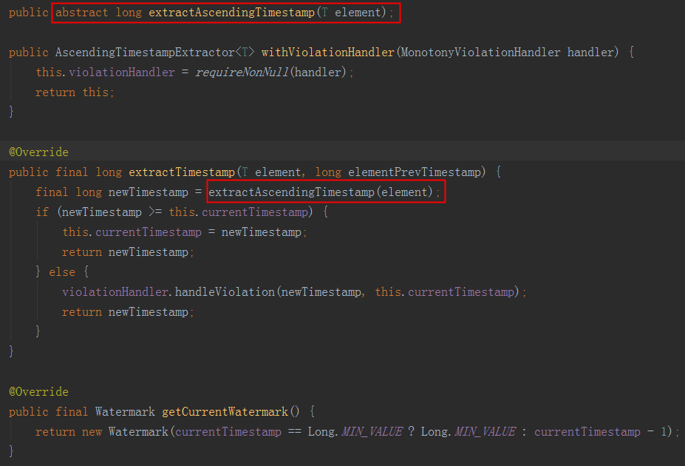
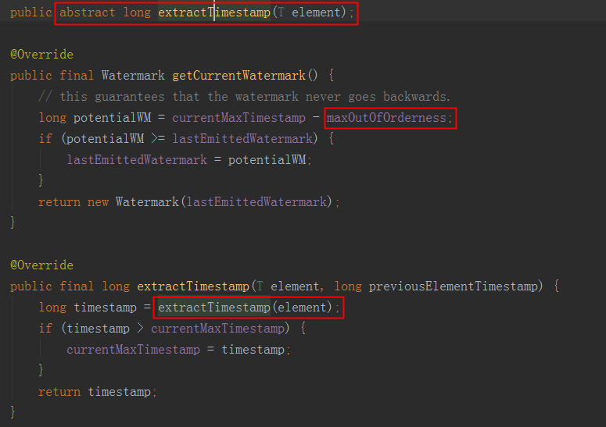
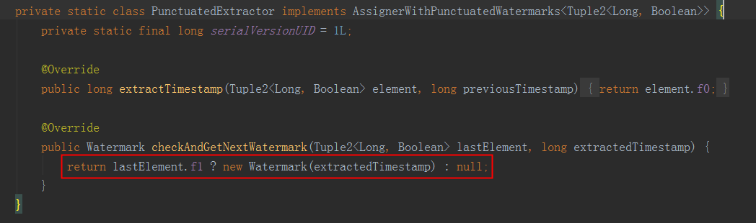
Flink watermarks

Slide 8
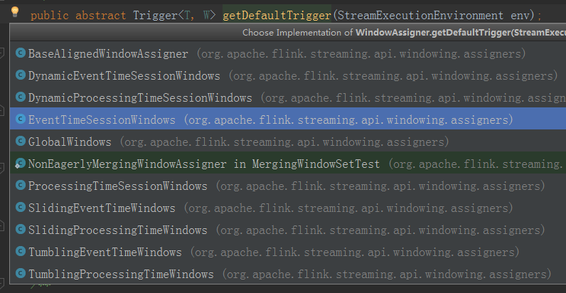
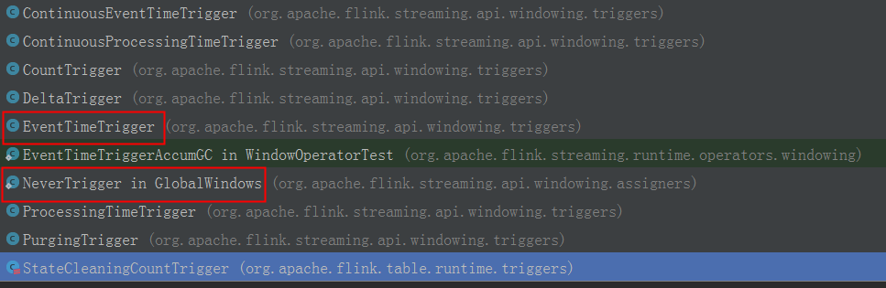
Flink triggers
trigger interface
The onElement()
The onEventTime()
The onProcessingTime()
The onMerge()
Finally the clear()
action
CONTINUE
FIRE
PURGE
FIRE_AND_PURGE
Default Triggers of WindowAssigners
GlobalWindow -> NeverTrigger

Slide 9
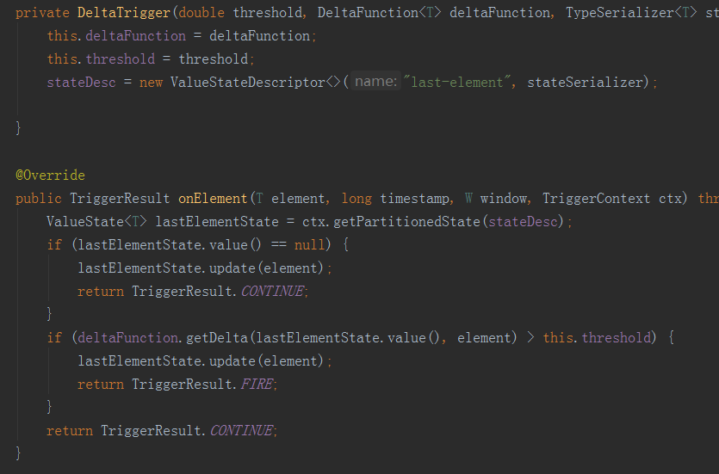
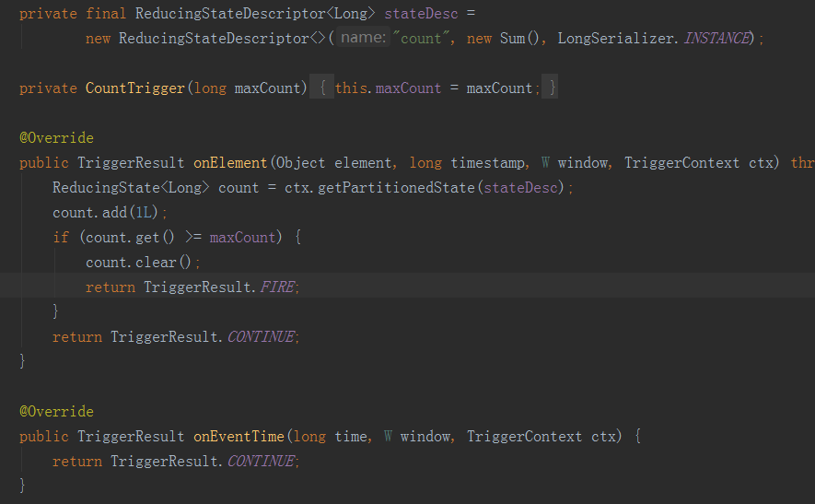
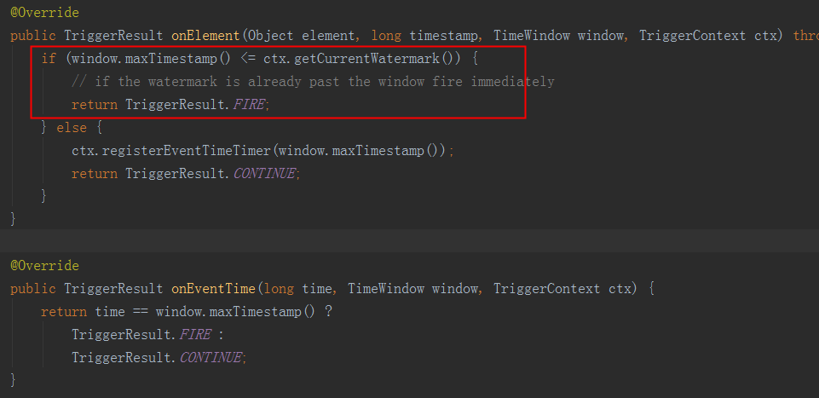
Flink triggers
countTrigger
DeltaTrigger
EventTimeTrigger

Slide 10
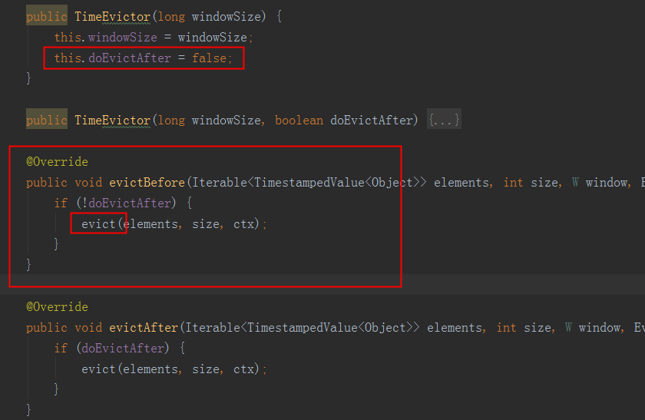
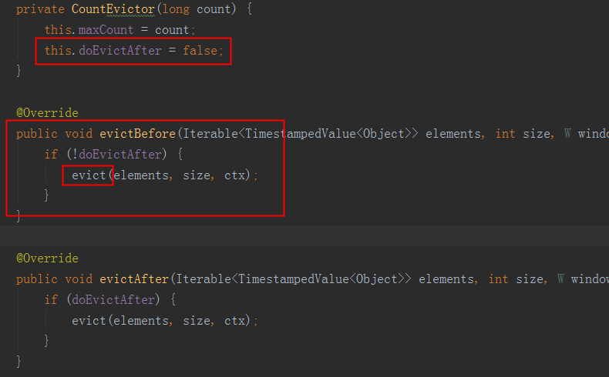
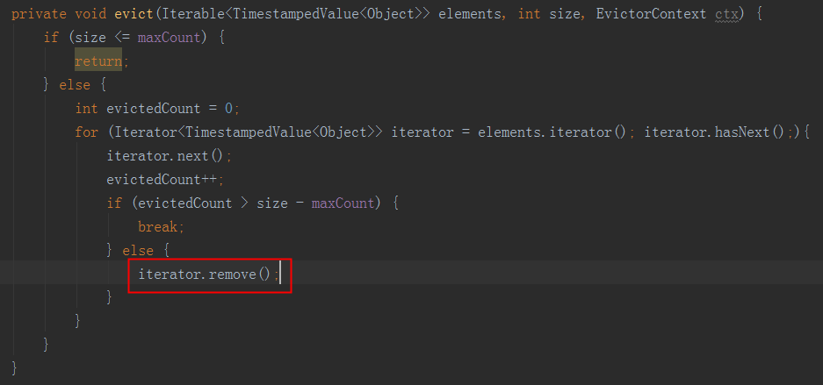
Flink Evictors
Evictors
optional
remove elements
after the trigger fires
before and/or after the window function is applied
Evictor interface
evictBefore()
evictAfter()
pre-implemented
CountEvictor
DeltaEvictor
TimeEvictor
Notes:
all the pre-implemented evictors apply their logic before the window function
CountEvictor: keeps up to a user-specified number of elements from the window and discards the remaining ones from the beginning of the window buffer.
DeltaEvictor: takes a DeltaFunction and a threshold, computes the delta between the last element in the window buffer and each of the remaining ones, and removes the ones with a delta greater or equal to the threshold.
TimeEvictor: takes as argument an interval in milliseconds and for a given window, it finds the maximum timestamp max_tsamong its elements and removes all the elements with timestamps smaller than max_ts - interval.

Slide 11
Flink Allowed Lateness
event-time windowing
late elements (default allowedLateness(0))
EventTimeTrigger
Flink keeps the state of windows until their allowed lateness expires
sideOutputLateData

Slide 12
Flink State & Fault Tolerance

Slide 13
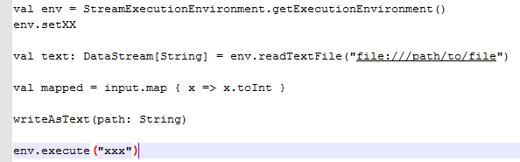
Anatomy of a Flink Program
DataSet and DataStream
Anatomy of a Flink Program
1.Obtain an execution environment
2.Load/create the initial/source data
3.Specify transformations on this data
4.Specify where to put the results of your computations
5.Trigger the program execution
Lazy Evaluation

Slide 14
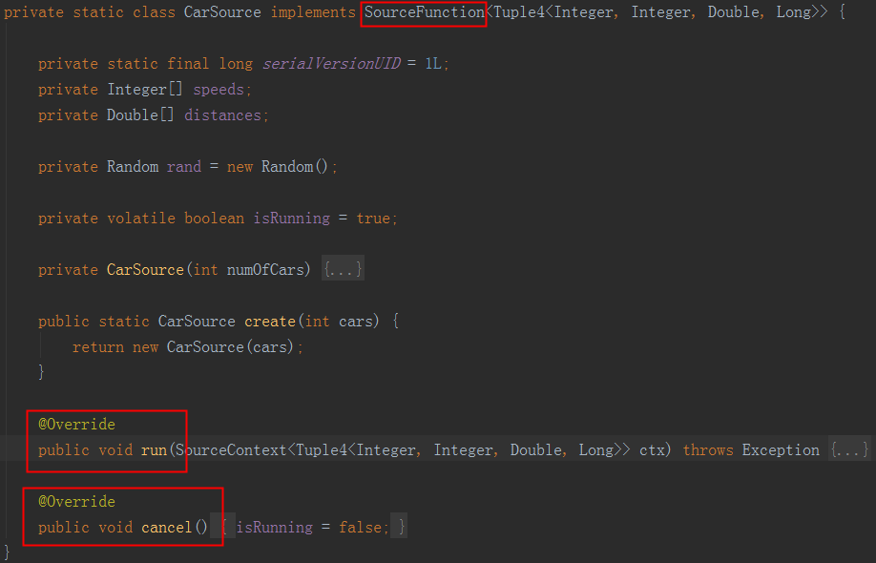
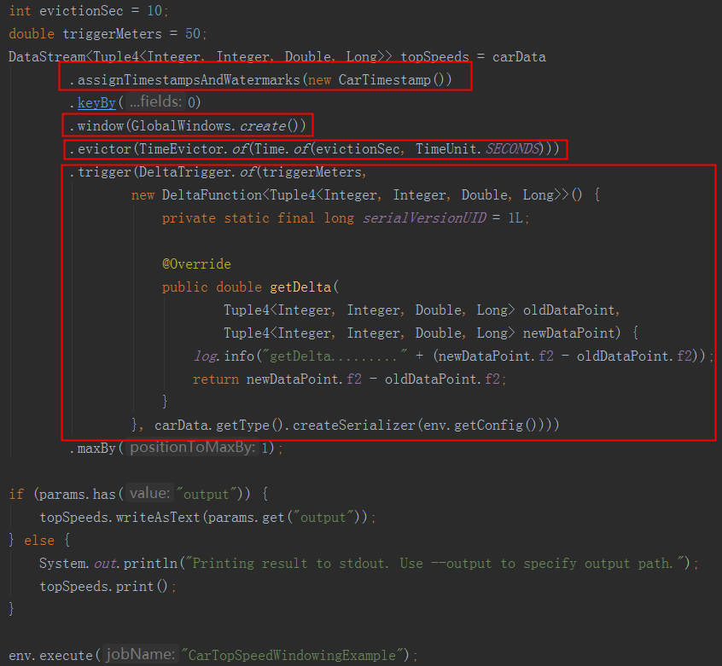
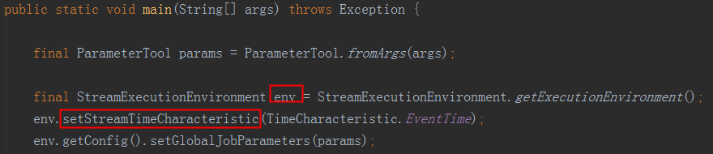
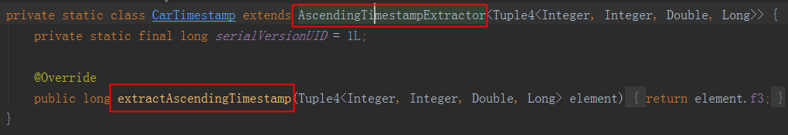
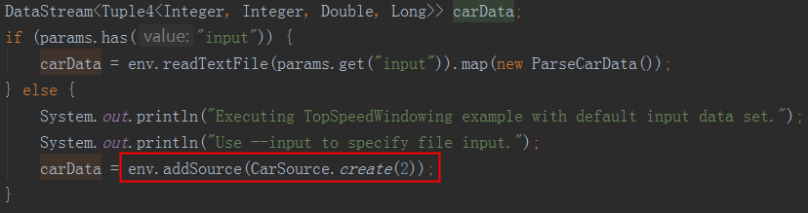
Flink hello world analysis

Slide 15
Flink training
Stateful (Connected Streams, Stateful Transformations)
Windowed Analytics(Event Time and Watermarks,Windows)
Event-time Timers(ProcessFunction,Side Outputs)
SQL Client

Slide 16
Links
https://www.ververica.com/blog
https://ci.apache.org/projects/flink/flink-docs-release-1.7

Slide 17
END

